Slide 1
Azure App Service

Slide 2
Agenda
Azure App Service
Web App creation
Deployment
Source Control Integration
Scale
Web Jobs
Site Slots
Backup
Hybrid Connections

Slide 3
Fastest way to build for the cloud

Slide 4
Host your applications on Azure
The three ways to host your applications on the Microsoft Azure Platform
Infrastructure as a Service
IaaS
Platform as a Service
PaaS
Notes:
Making the point that Virtual Machines is IaaS while both CloudServices and Websites are PaaS.

Slide 5
Demo: Web App Creation

Slide 6
Azure App Service Overview and Architecture

Slide 7
Azure Websites
Mobile Services
BizTalk Services
Key app services in Azure today

Slide 8

Introducing Azure App Service
Unique integrated offering
Build rich, engaging & intelligent apps
Scale as your business grows
Azure Websites
Mobile Services
BizTalk Services
Key app services in Azure today

Slide 9
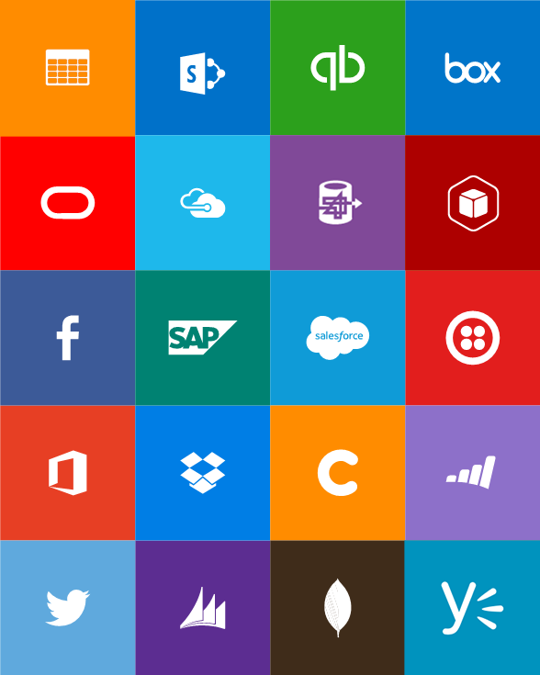


Slide 10
One price

Slide 11
Full capability set available including:
.NET, Node.js, Java, PHP, and Python
WebJobs for long running tasks
Integrated VS publish, remote debug…
CI with GitHub, BitBucket, VSO
Auto-load balance, Autoscale, Geo DR
Virtual networking and hybrid connections
Site slots for staged deployments
Web Apps
Web apps run as-is
no changes required

Slide 12
New capabilities for Mobile apps:
Webjobs for long running tasks
CI with GitHub, BitBucket, VSO
Auto-load balance, Autoscale, Geo DR
Virtual networking and hybrid connections
Site slots for staged deployments
Mobile Apps
Mobile services plus
a whole lot more

Slide 13
New Logic Apps for easy automation
No code designer for rapid creation
Dozens of pre-built templates to get started
Out of box support for popular SaaS and on-premises apps
Use with custom API apps of your own
Biztalk APIs for expert integration scenarios
LOGIC Apps
Automate SaaS and
on-premises systems

Slide 14

Easily use cloud or custom APIs:
Dozens of built-in APIs for popular SaaS
An ecosystem of APIs for any need
Create and publish custom, reusable APIs
Visual Studio tooling with one click publish and remote debugging
Automatic client SDK generation for many languages
Api Apps
Create, consume and
host APIs more easily

Slide 15
Built-in API Connectors
Connectors
Box
Chatter
Delay
Dropbox
Azure HD Insight
Marketo
Azure Media Services
OneDrive
SharePoint
SQL Server
Office 365
Oracle
QuickBooks
SalesForce
Sugar CRM
SAP
Azure Service Bus
Azure Storage
Timer / Recurrence
Twilio
Twitter
IBM DB2
Informix
Websphere MQ
Azure Web Jobs
Yammer
Dynamics CRM
Dynamics AX
Hybrid Connectivity
Protocols
BizTalk Services
HTTP, HTTPS
File
Flat File
FTP, SFTP
POP3/IMAP
SMTP
SOAP + WCF
Batching / Debatching
Validate
Extract (XPath)
Transform (+Mapper)
Convert (XML-JSON)
Convert (XML-FF)
X12
EDIFACT
AS2
TPMOM
Rules Engine

Slide 16
App Service
Web Apps
Mobile Apps
Web apps that scale with your business
Build Mobile apps for any device
LOGIC Apps
Api Apps
Automate business process across SaaS and on-premises
Easily build and consume APIs in the cloud

Slide 17
App Service
End-to-end car dealership example
Customer book appointment
Service Advisor assigns a technician
Service Technician closes out service work
Web Apps
LOGIC Apps
Mobile Apps
Api Apps

Slide 18



App Service
Web Apps
LOGIC Apps
Mobile Apps
Customer site
Service Advisor
Customer Appointment
Technician App
Web Apps
LOGIC Apps
Mobile Apps
Api Apps
Api Apps
http
SQL

Slide 19
Web Apps
LOGIC Apps
Mobile Apps
Customer site
Service Advisor
Customer Appointment
Technician App
Api Apps
http
SQL

Slide 20
Best Practices for Cloud managed Websites
Scalable design
Eliminate Single point of failures
High Availability/Fault tolerance
Setup Monitoring and Alerts
Automate Infrastructure such as Deployment, Log parsing
Self-Healing (Detect issues and restart the instance)
Proactively avoid failures (fire drills, test for failures and recovery procedures)
Notes:
Build an Architecture that is ^

Slide 21
Web Apps in Azure App Service
Notes:
File / New Web Application
Show Host In The Cloud dialog
Select Empty web site (for quick create)
Right-click project, select Publish
Show Web App creation
Cancel publish
Show Web App in Server Explorer
Right-click one Web App and show settings

Slide 22

Develop apps with…
.NET
Python
Node.js
Java
PHP
Web App

Slide 23
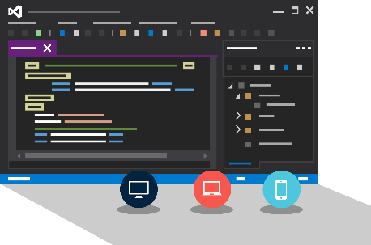
Visual Studio + App Service Web Apps
Create Azure Resources during File / New
Create Web App during deploy
Manage with Server Explorer

Slide 24

Source Control
Git
Visual Studio
Online
CodePlex
GitHub
BitBucket
DropBox
FTP
Choose your own adventure!
Notes:
Slide Objectives:
Objective #1
Transition:
Transition statement(s) to setup the slide
Speaking Points:
Speaking Point #1
Speaking Point #2
Notes:
Any notes go here

Slide 25
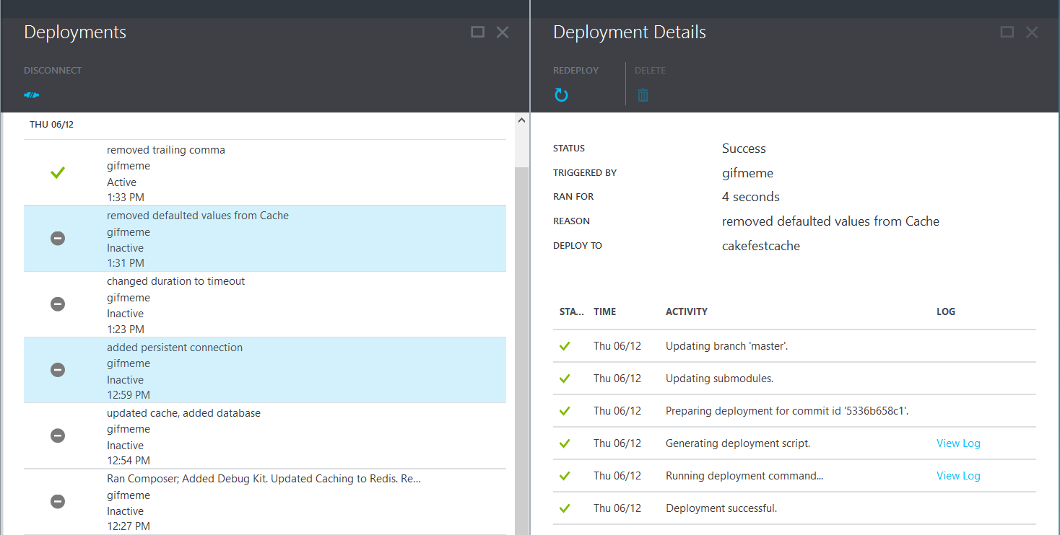
Deployments

Slide 26
Scale

Slide 27
Manual Scaling
Instance Count
1
6
Instances

Slide 28
AutoScale
Web App

Slide 29
AutoScale
Web App

Slide 30
AutoScale
Web App

Slide 31
Auto-Scaling (Metrics)
Instance Count
2
6
Instances
[Metric]
60
80
Percent
CPU Percentage
Memory Percentage
Disk Queue Length
HTTP Queue Length
Data In
Data Out

Slide 32
Demo: Manual/Auto Scale

Slide 33
Auto-Scale Considerations
Only Scales the Web Tier
Scale Up/Down is not instantaneous

Slide 34
Web Jobs

Slide 35
WebJobs
Web App

Slide 36
WebJobs
Web App

Slide 37
Traffic Manager

Slide 38
17 regions worldwide in 2015
App Service Web App footprint

Slide 39
Intelligent customer routing with Traffic Manager
www.yourapp.com

Slide 40
www.yourapp.com

Slide 41
Application Insights

Slide 42
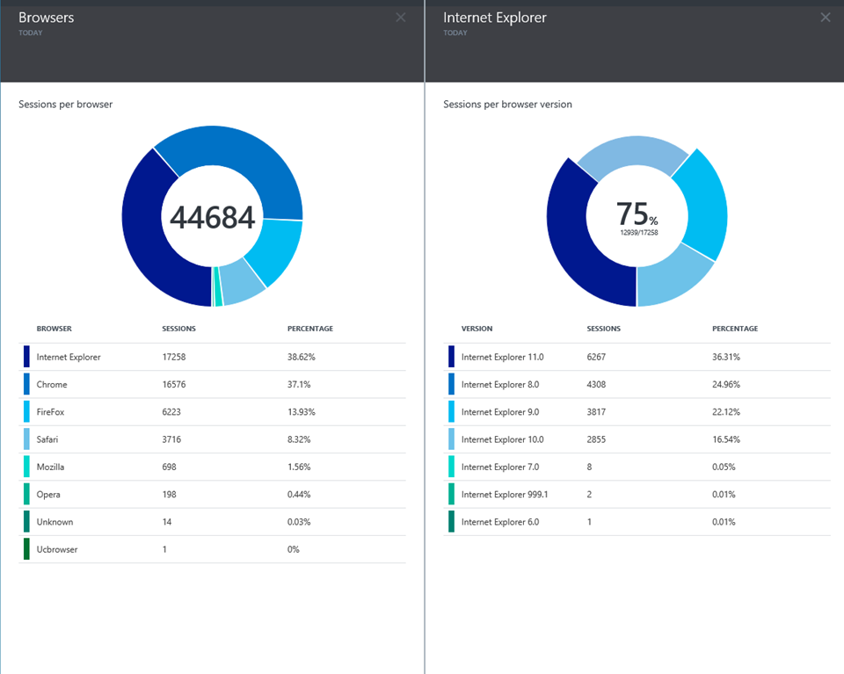
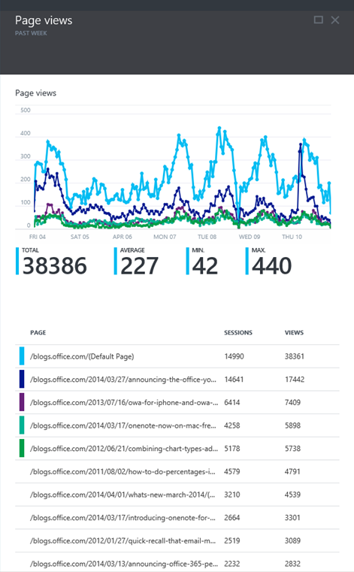
Application Insights
Application Insights

Slide 43
Q&A

